Slide 1


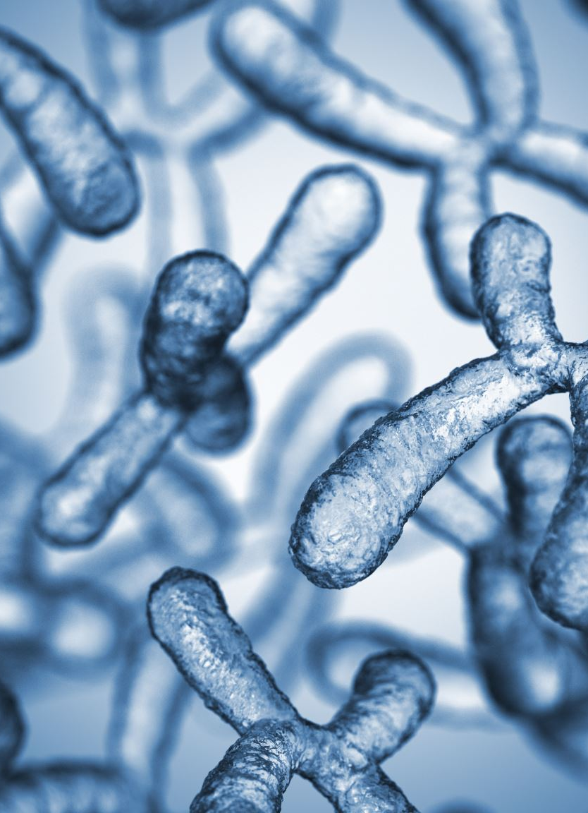



Building the
Synoptic Key of
Life website
La Monte Henry Piggy Yarroll
MASMC 2026
2026-04-25
North Carolina Agricultural and Technical State (NCA&T) University
Notes:
I’m La Monte Henry Piggy Yarroll, and I’m presenting a new tool to help mainly amateurs navigate the open and public domain taxonomic literature by creating detailed taxonomic descriptions. This work is part of my Master’s Degree in Applied Data Science at Syracuse University.
I’ll discuss the construction of the system, and then I’ll walk through the user interface.

Slide 2
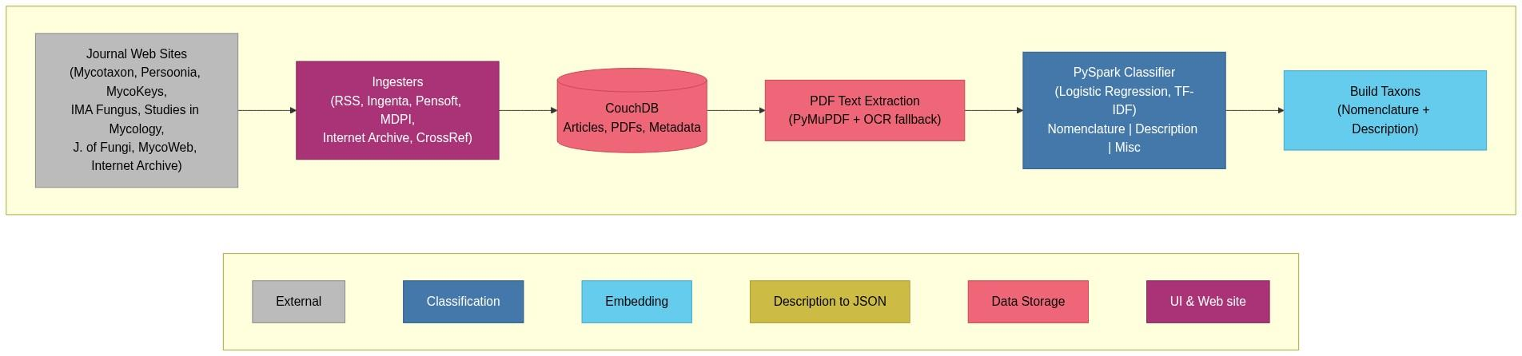
SKOL Architecture by Implementation Project (1 of 2)
Notes:
Here is an overview of the SKOL Architecture as seen through subprojects. On the left we have the web sites that we scrape for articles and the ingestors that keep the local copies of journals up to date. The next two blocks represent data storage and cleaning. This dark blue block is a PySpark pipeline that builds a classifier to extract species names and their descriptions from the literature. These names and descriptions are combined into Taxa objects in the light blue box.

Slide 3
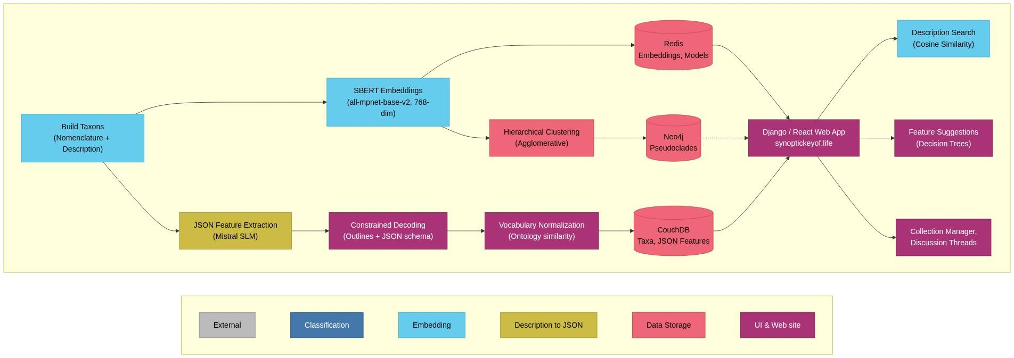
SKOL Architecture by Implementation Project (2 of 2)
Notes:
The taxa are then processed in two separate paths.
The upper path uses an embedding into a searchable semantic space with the SBERT Small Language Model. This embedding is then used to find taxa that are similar to a description provided by the user.
The lower path uses a different Small Language Model, Mistral 7b, which translates the free form text description into a hierarchical representation of features, subfeatures, and values. These representations are refined through constrained decoding, which limits the output to valid JSON structures. The vocabulary is then normalized using similarity to published ontologies.
Finally, we have the web site built with Django and React.

Slide 4

YEDDA Annotation (Classification)
[@2. Vibrissea filisporia (Bonord.) Korf & A. Sánchez f.
boudieri A. Sánchez & Korf in Sánchez, J. Agric.
Univ. Puerto Rico 51: 83, 1967.
FIGS. 3, 4 & 5.#Nomenclature*]
[@APOTHECIA sessile, discoid, 0.75-1 mm in diameter.
RECEPTACLE brown. DISC convex, buff when rehydrated.
HYMENIUM making up to 3/4 of the apothecium, asci taking up
most of the height. ECTAL EXCIPULUM brown, 65.3-76.4 µm
wide, of textura globulosa, with cells turning outwards#Description*]
Notes:
Starting from the dark blue box, the Classifier, we have an example of a labeled taxon as produced by the Classifier. Note the Nomenclature and Description annotations.

Slide 5


Dr Draft's state-of-the-art (SOTA) Literature Search
Notes:
We extended a tool developed by Nick Gisolfi of the Auton Lab at Carnegie Mellon to search the open mycological literature for species descriptions. The SBERT embedding of descriptions from the literature can be compared to a description provided by the user to find the most similar descriptions. Since the search is semantic, that is to say meaning-based, the exact vocabulary chosen by the user does not matter very much. We can say “stem” or “stipe” and get mostly the same matches. Even though I’ve yet to do anything special for languages-other-than-English, I’ve even gotten good matches with Latin and German results.

Slide 6

Description to JSON
{
"mycelium": {
"location": "on substrate",
"color": "medium orange-brown"
},
"hyphae": {
"septate": true,
"diameter_um": {
"min": 3,
"max": 4
},
"surface": "distinctly and coarsely rough",
"orientation": "parallel to long axis of substrate tissue cells",
"branching": {
"location": "on exterior",
"pattern": "non-patterned network"
}
},
"sporulation_units": {
"origin": "enlarging tips of short branches",
"color_progression": [
"concolorous with surface mycelium",
"dark orange-brown",
"black-brown and opaque"
],
"attachment": {
"occasional": "attached to hypha",
"typical": "broken loose or obscured by crowding and opacity"
}
}
}
Can you extract any attributes and their measurements from the
following description of an organism? Present the result as a json data
structure.
Mycelium on the substrate is medium orange-brown, septate, 3-4 µm
diam., often distinctly and coarsely rough; hyphae often run parallel to the
long axis of cells in substrate tissue but usually branch on the exterior and
appear as a non-patterned network. Sporulation units are produced as
enlarging tips of short branches, at first concolorous with surface
mycelium but soon dark orange-brown and finally black-brown and
opaque. In type material an occasional enlarging branch can be seen
attached to the hypha from which it developed; in most instances,
however, the enlarged branch elements have broken loose from the
mycelium or are so densely crowded on the substrate and so nearly opaque
that points of attachment cannot be traced
Notes:
Here we have a typical prose description. We use Mistral 7b to translate prose descriptions into a hierarchy of feature, subfeature, and value. This hierarchical form allows further manipulation of the descriptions for making menus and feature selection tools.

Slide 7
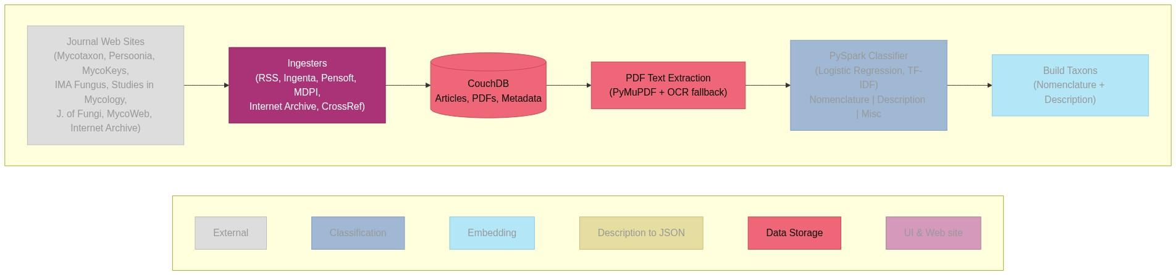
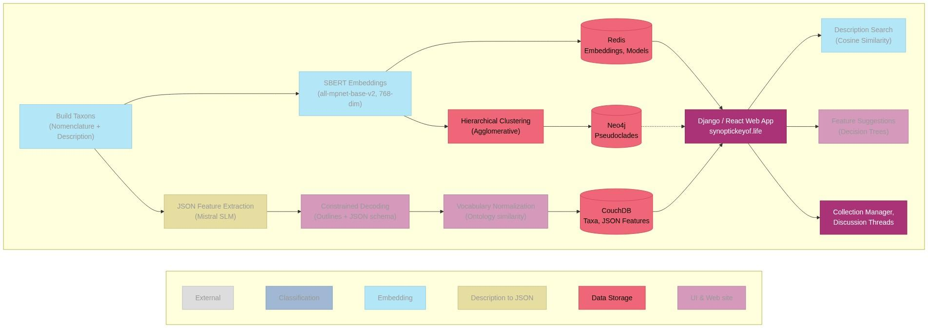

Notes:
One of the subprojects concentrated on storage technologies. This was the start of integrating pieces from the other projects into a single deployable system. This project was the first I did after learning to use Claude Code, an AI coding agent. Claude really enabled the rest of the work, allowing me to concentrate on behaviors and design, with only light review of code produced by Claude.
I used pypaperretriever and paperscraper for web ingestion.
A CouchDB JSON database holds a lot of the core data: Scraped journals and books, metadata, taxa records, JSON descriptions.
A Redis in-memory dictionary holds various generated structures needed by the web site including: Models, Fungaria records, and Generated menus.
A PostgreSQL SQL database holds the Django ORM for user accounts, collections, metadata.
I used Neo4j to visualize the SBERT embeddings.

Slide 8
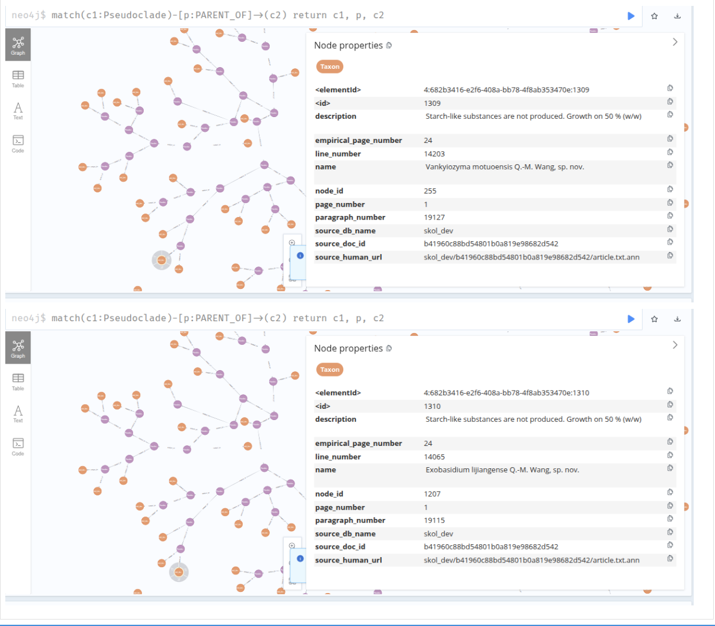
Pseudoclades
Notes:
Here is a visualization with Neo4j of pseudoclades based on similarity distance in SBERT embeddings.
The next few slides give more detail on the web site.

Slide 9
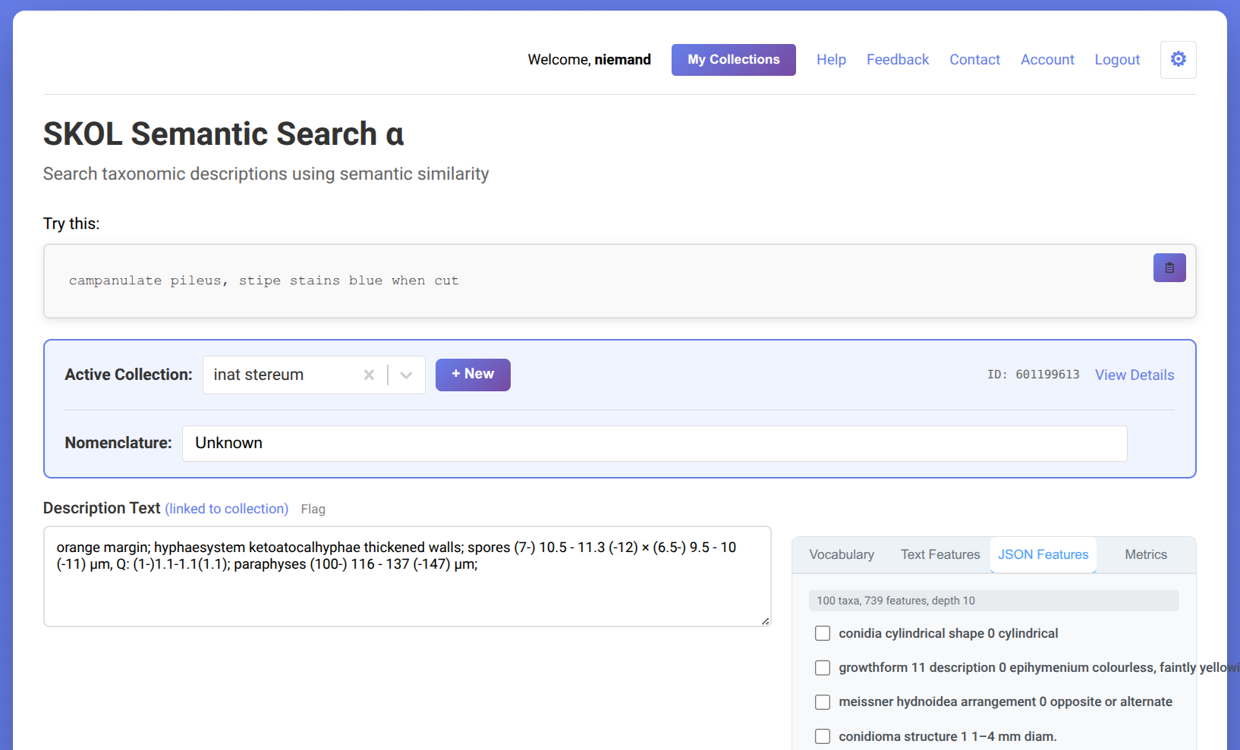

Search Page (showing JSON Feature Tool)
Notes:
Here is the Search Page from the web site. Here we have the in-progress description built by the user. On the right, we have a set of tools for refining the description.
Each collection can have a descriptive name, and the taxonomist’s best guess on a name.
Every change is automatically tracked.

Slide 10
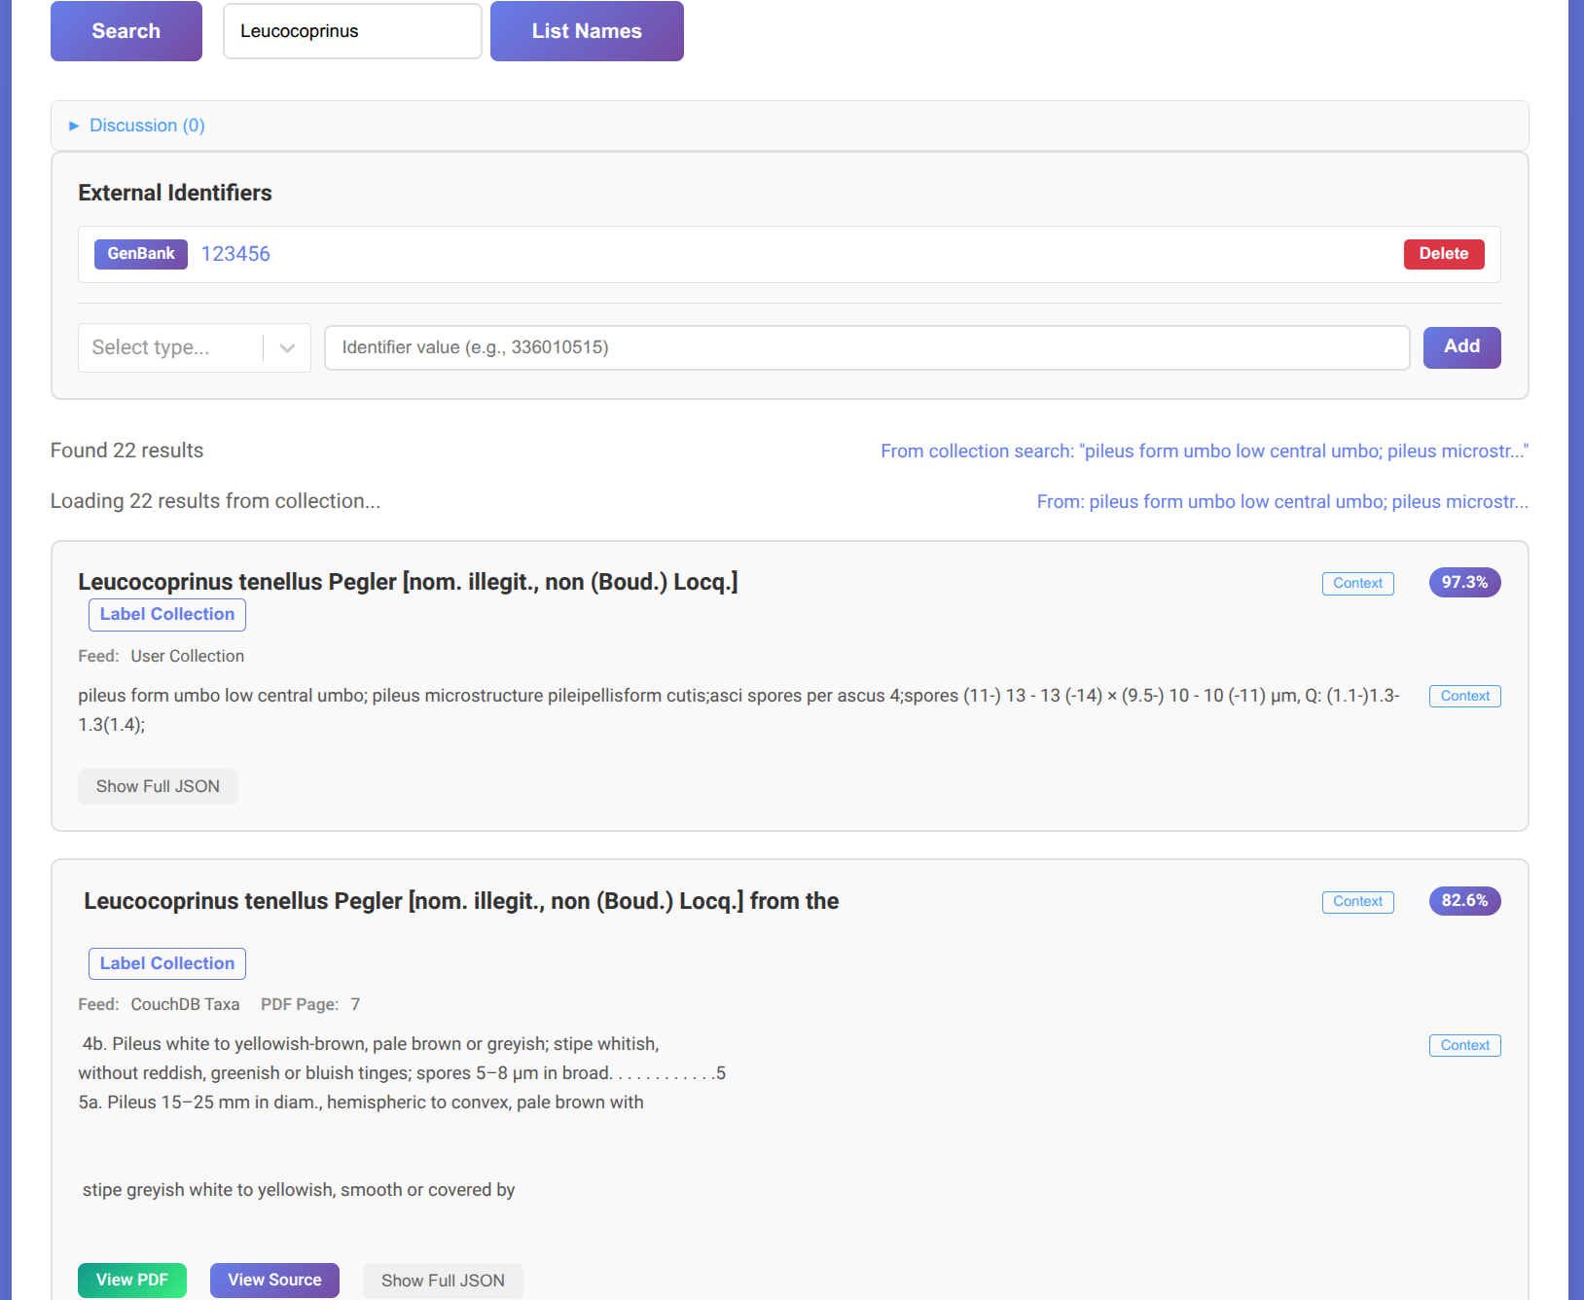
Search Results
Notes:
This is a search result page. We have the full species name and description from the literature. We also provide links to a local PDF if it is available, and the link back to the original source.
We can also associate identifiers from other repositories, such as iNat or MO numbers, or accession numbers for a fungarium. A planned feature will allow the taxonomist to add a description to the iNat entry with a single click.

Slide 11
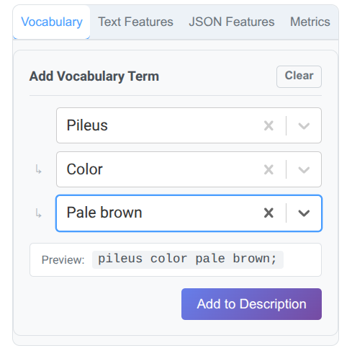
Vocabulary Feature Tool
Notes:
This is the simplest of the feature tools, which creates nested menus base on the JSON hierarchical representations of descriptions. This is a static set of menus and is not tied to the current description.

Slide 12
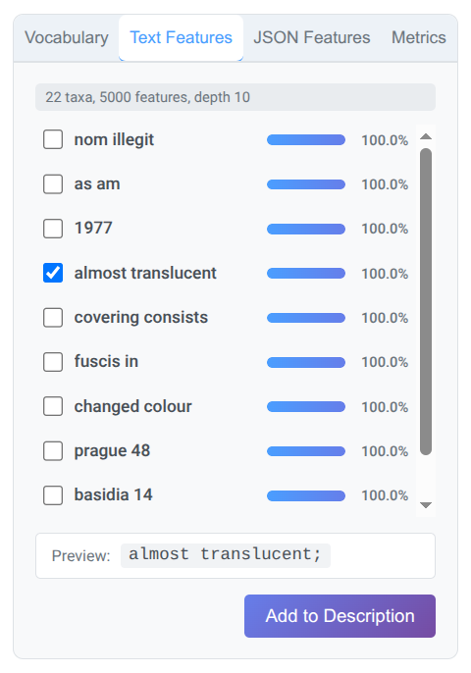
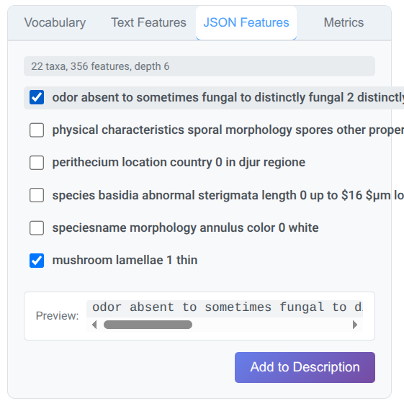
Text and JSON Feature tools
Notes:
These two tools are based on decision tree models built on-the-fly from the top few taxa that most closely match the current description. The decision tree on the left is based on just the vocabulary of the descriptions. The decision tree on the right is based on the hierarchical JSON representation.
Each feature is a vertical cut through a JSON representation, from feature down to value. The user is invited to edit the preview to reflect their collection.

Slide 13
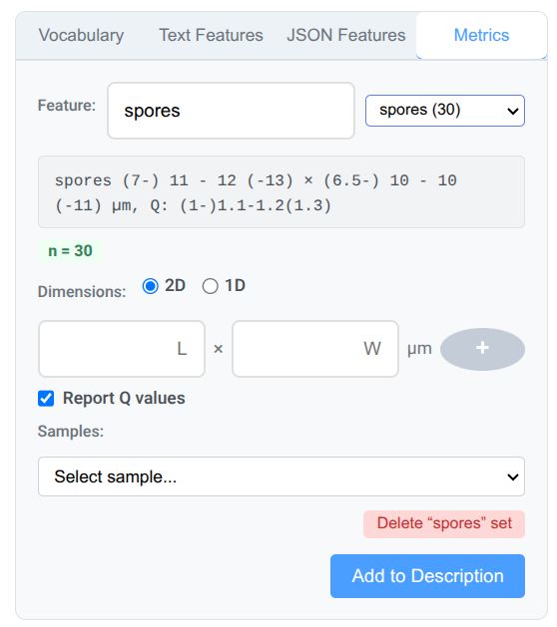
Metrics Description Tool
Notes:
The final feature tool helps the user collect statistics for microscopic features. It keeps a permanent record of every measurement. The count n turns green once it gets to 30. Metrics can be 1 dimensional (e.g. length of paraphyses), or 2 dimensional (e.g. spores). 2D measurements can also report Q value (ratio of length to width). A Q value of 1.0 indicates round spores. Higher Q values indicate more elongated spores.
The user can add whatever measurable feature they care to.

Slide 14
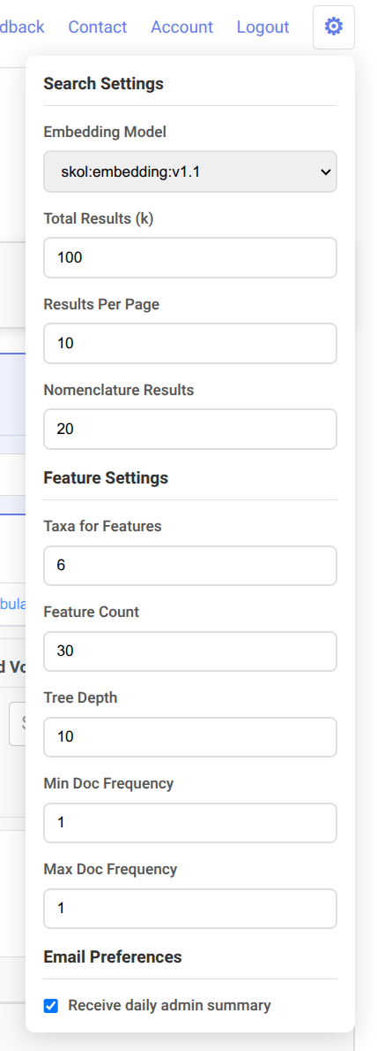
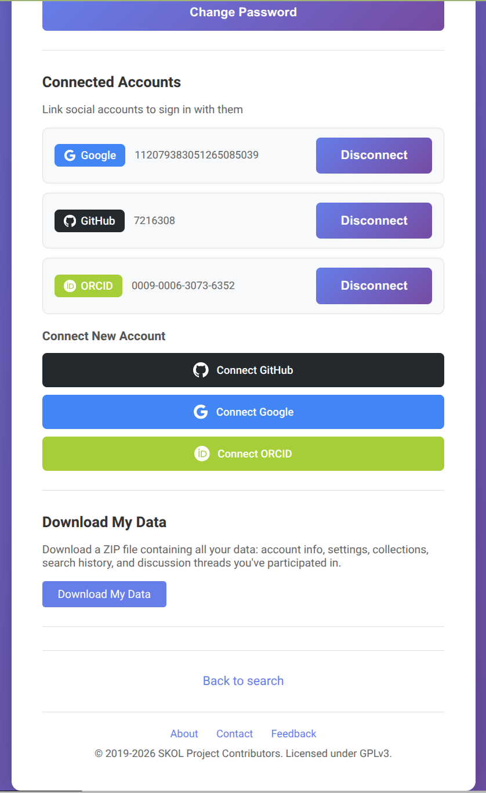
Account and Settings
Notes:
The web site also includes typical features like account and settings management.
The site supports logging in with local credentials or credentials from GitHub, Google, or ORCID. I’m hoping to add iNaturalist soon. If GitHub credentials are available, they will be used to create GitHub Issues for Feedback messages.
The settings include the embedding model to use for semantic search. The default model includes all records, which includes all records from the literature and all records generated by site members. Site members may elect to embargo their descriptions for up to 1 year to allow for publication. Additional models will be available in the future, e.g. I plan to add a dichotomous key detector.
Other settings control the number of results retrieved for a search, the number displayed at a time, and the number displayed for a Nomenclature search.
The feature settings control generation of decision trees.
The system currently has a single daily report which anybody can subscribe to. This report covers all activity on the site. We will add additional reporting options once the admin report gets too verbose.

Slide 15
Future
Currently in alpha-test
Data quality project, especially for older material
Glossary tools
Better multi-language support
More journals and books
Expand to other groups of organisms
See https://trello.com/b/jUkRE6zv/skol for a complete backlog.
Notes:
I plan to keep working on this for some years to come.
The web site is currently in alpha test. This means that data may go away, so be sure to download your data regularly. That said, I’m pretty confident that the data formats are stable and a complete database reset is unlikely.
The compute resources of the current production machine are pretty limited. I think we can support up to three simultaneous searches, though that drops to zero while rebuilding the embeddings. Right now, embeddings are rebuilt at 6am ET and take less than a half an hour.
I have a data quality project whose completion will trigger beta test.
I’d like to add a glossary tool that lets you hover over technical terms to get definitions.
Precalculated translations of LOTE descriptions are in the moderately near future.
Check the sources page for a current list of journals. Feedback on additional open access journals is solicited.
Eventually, I’d like to expand this to cover other organisms. My short list includes bryophytes. Note that myxomycetes are already included.
See our public Trello for a complete backlog of plans.

Slide 16
Acknowlegements
Development team
Dr. Gregory Block (Faculty advisor)
Christopher Murphy
Jennifer Balasi
Shintaro Osuga
David Caspers
Padmaja Kurumaddali
Patrick Le
Alpha testers
Garrett Taylor
Richard Jacob
Notes:
These are my collaborators, so far.
Feel free to create an account for yourself and play with the web site!

Slide 17
These slides:
https://tinyurl.com/ykwt8dkv
The accompanying paper:
https://tinyurl.com/54paunua
The SKOL web site:
https://synoptickeyof.life/skol
The SKOL source code:
https://github.com/piggyatbaqaqi/skol
Dr Draft's state-of-the-art (SOTA) Literature Search
https://github.com/autonlab/dr-drafts-sota-literature-search
SKOL fork of Dr Draft’s:
https://github.com/piggyatbaqaqi/dr-drafts-mycosearch
A complete summary of technologies integrated:
https://github.com/piggyatbaqaqi/skol/blob/main/docs/technologies.md for.
Notes:
Here are links for those interested in diving deeper.

Slide 18
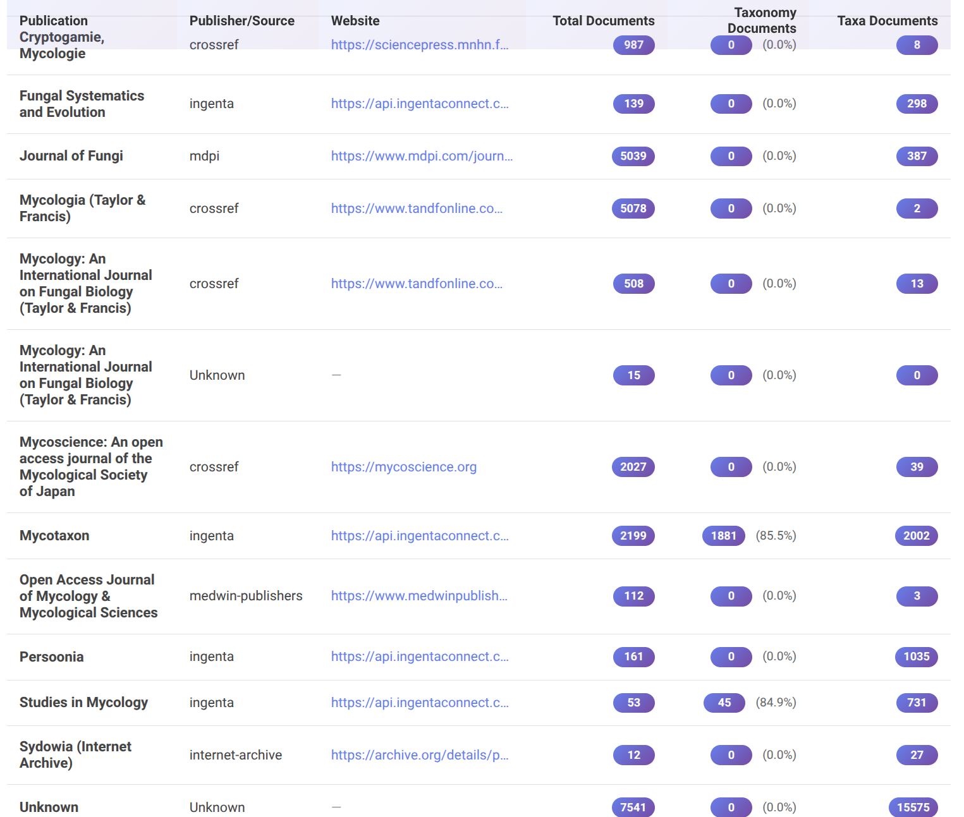
Appendix: Sources
Notes:
Here is the current list of journals.
A lot of public domain books are lumped together under “Unknown”. I need to fix the ingesters for local files to provide better metadata.

